Slide 1

Real Time Violence Detection using Machine Learning
Project Guide
Prof. Sarala Mary
Student ID | Group Member
21107015 | Pooja Kumbhar
21107048 | Veena Sharma
21107066 | Sanika Shelke

Slide 2
Outline
Introduction
Literature Survey of the existing systems
Limitations of the existing systems
Problem statement
System Design
Technologies and methodologies
Implementation
Conclusion
References

Slide 3
Introduction
A violence detection system serves the critical purpose of
automatically identifying aggressive or harmful behavior in various
contexts.
Real-time violence detection with the use of surveillance is the
process of using live videos to detect violent and irregular behavior.
Motivation
• The primary motivation is to enhance public safety and security
in various environments, including public spaces, transportation
hubs, schools, and entertainment venues.
• By detecting violent incidents early, we can prevent harm to
individuals and maintain order.
• Detecting violence promptly allows for timely intervention. It
prevents situations from escalating and minimizes potential
damage.

Slide 4
Objective
To Design and develop an automated system capable of detecting violent behavior in real-time video streams from various sources (such as surveillance cameras, public spaces,images).
To Achieve high accuracy in identifying violent actions while minimizing false positives.
To analyze video stream in real time and detect violent actions as they occur by using OpenCv and Tensorflow object detection.

Slide 5
Literature Survey of the existing system
Title | Author(s) | Year | Outcomes | Methodology | Result
Video Representation Learning for CCTV-Based Violence Detection | Silva Deena J, MD. Tabil Ahammed, Udaya Mouni Boppana, Maharin Afroj, Sudipto Ghosh, Sohaima Hossain [2] | 2022 | Ability to automatically recognize violence behaviors is one of the key technology for CCTV cameras. However, it is still a challenging task to obtain effective features for detecting violence in CCTV videos due to the visual quality of the video data. . | we propose a novel representation learning approach to improve the detection rate of violent behaviors in videos. Our proposed approach consists of two parts. In the first part, we leverage features extracted from image-based deep convolution neural network to describe spatial information in a video frame. | a bidirectional long-short term memory (LSTM) is applied to learn a video-level classifier from both violent/non-violent video sequences.
Violence Detection in Real Life Videos using Convolutional Neural Network | Nandini Bagga; Gajan Singh; Balamurugan Balusamy; Ajay Shanker Singh[1] | 2023 | This research paper explores how violence must be identified on real-time films taken by numerous surveillance cameras at all times and in all locations, which makes it difficult to perform | The methodology involvesFor image categorization, there are numerous pre-trained convolutional neural networks available. | The result showcases a comprehensive understanding of violence detection and their pivotal role in information retrieval.

Slide 6
Literature Survey of the existing system
Title | Author(s) | Year | Outcomes | Methodology | Result
CNN features with bi-directional LSTM for real-time anomaly detection in surveillance networks | Waseem Ullah Amin Ullah Ijaz Ul Haq Khan Muhammad Muhammad Sajjad Sung Wook Baik [3] | 2021 | In this paper, we present an efficient deep features-based intelligent anomaly detection framework that can operate in surveillance networks with reduced time complexity. . | In current technological era, surveillance systems generate an enormous volume of video data on a daily basis, making its analysis a difficult task for computer vision experts. Manually searching for unusual events in these massive video streams is a challenging task, since they occur inconsistently and with low probability in real-world surveillance | The results of We performed extensive experiments on various anomaly detection benchmark datasets to validate the functionality of the proposed framework within complex surveillance scenarios.

Slide 7
Limitations of existing systems
Environmental Sensitivity: These systems can struggle to perform consistently across different environmental conditions. Factors such as varying lighting, background clutter, and camera angles can affect their accuracy, leading to false alarms or missed detection.
High False Alarm Rates: Due to the complexity of distinguishing between violent and non-violent actions, real-time violence detection systems may produce a high rate of false alarms
Algorithmic Accuracy: Some existing algorithms rely on less accurate methods or infeasible assumptions. Achieving high accuracy while maintaining real- time performance remains a challenge.
Rare Occurrence of Violent Events: Violent events are relatively rare in normal videos, making their detection challenging.Anomaly detection and processing videos with varying backgrounds, illumination conditions difficulties.

Slide 8
Limitations of existing systems
Complexity of Violence: The differentiating between violent and non-violent actions, especially in crowded or dynamic environments, poses a significant challenge for detection algorithms.

Slide 9
Problem statement
The need arises for an efficient and accurate system capable of
automatically identifying and reporting violent actions within video
streams. This real-time violence detection system aims to:
Analyze video data (from surveillance cameras) to detect the presence of violence.
Enable swift and effective responses from relevant authorities by providing timely alerts.

Slide 10
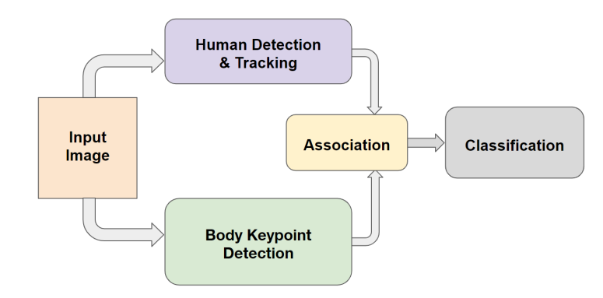
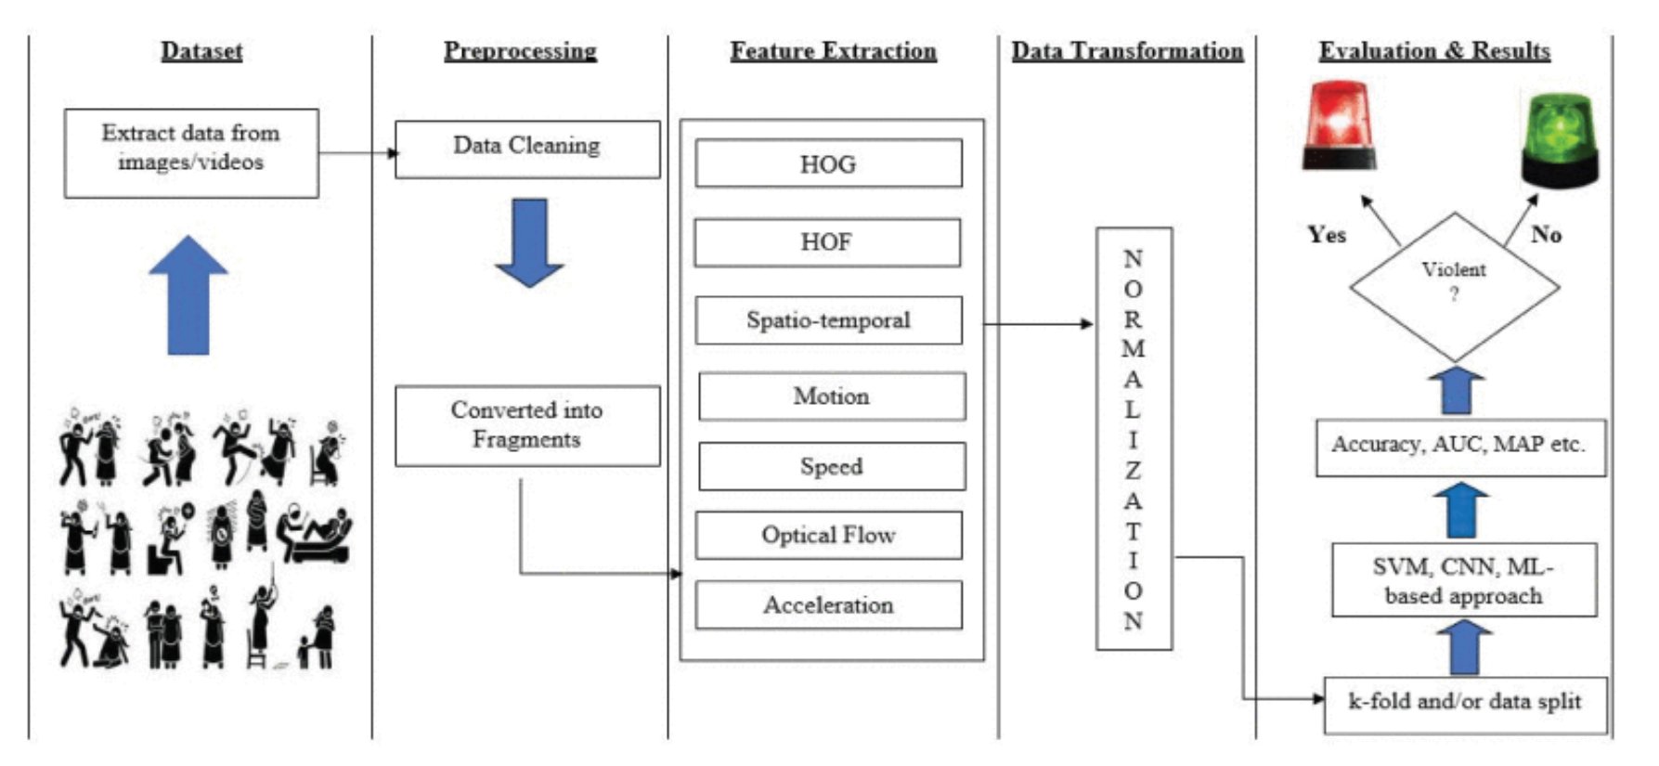
System Design

Slide 11
Technologies and methodologies
Python 3.11
Pycharm 2022.2.2
Library :-
Tensorflow 1.15
keras
Numpy 1.16
Machine Learning:
-CNN(Conventional Neural Network)
using keras sequential API

Slide 12

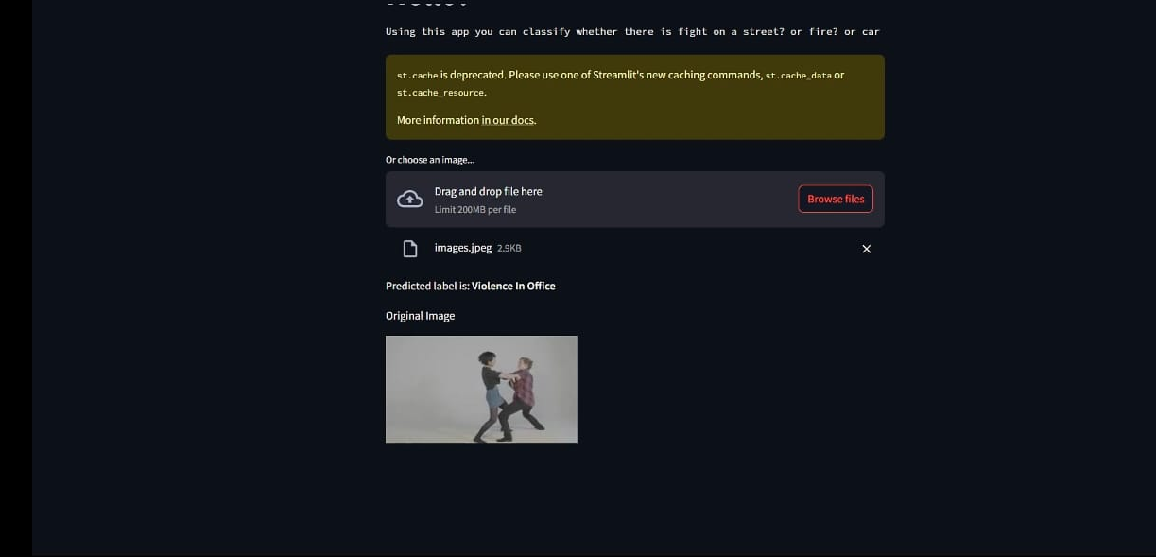
Implementation

Slide 13
Conclusion
In an increasingly interconnected world, ensuring safety and security
is paramount. A violence detection system serves as a powerful tool to
achieve this goal. By leveraging advanced technologies, real-time
monitoring, and automated analysis, such systems contribute
significantly to public safety

Slide 14
References
Nandini Bagga,Gajan Singh, Balamurugan Balusamy, Ajay Shanker Singh(2022)Violence Detection in Real Life Videos using Convolutional Neural Network.
Silva Deena J, Md. Tabil Ahammed, Udaya Mouni Boppana, Maharin Afroj, Sudipto Ghosh, Sohaima Hossain(2022)Real-time based Violence Detection from CCTV Camera using Machine Learning Method.
Ullah A, Ahmad J, Muhammad K, Sajjad M, Baik SW (2017) Action recognition in video sequences using deep bi-directional LSTM with CNN features.

Slide 15
Thank You...!!

